Slide 1


Slide 2
Quadratic Equations

Slide 3
Identifying Quadratic Patterns
A quadratic equation, denoted by the variable x, takes the form of ax² + bx + c = 0, where a, b, and c represent real numbers, with a ≠ 0. For instance, 2x² + x - 300 = 0 is a quadratic equation. However, to establish the standard representation of this equation, we arrange the terms of p(x) in descending order of their degrees, resulting in ax² + bx + c = 0, with a ≠ 0. This particular form, ax² + bx + c = 0, where 'a' is not equal to zero, is referred to as the standard form of a quadratic equation.

Slide 4
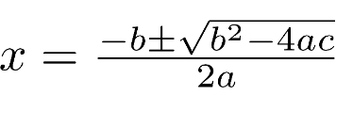
The Quadratic Formula
The Quadratic Formula is a rule that says that, in any equation of the form ax² + bx + c = 0, the solution x-values of the equation are given by:

Slide 5
Factoring Quadratic Equations
Factoring quadratics is a technique used to represent the quadratic equation ax^2 + bx + c = 0 as a multiplication of its linear factors in the form (x - p) (x - q), where p and q represent the roots of the quadratic equation ax^2 + bx + c = 0.
Factoring Techniques Quadratic equations can be factorized through various methods such as
Splitting the middle term,
Using quadratic formula or Shridharacharya formula
Completing the square or square root method

Slide 6
NATURE OF ROOTS
VALUE OF DISCRIMINANT | NATURE OF ROOTS
D>0 | REAL,DISTINCT
D IS A PERFECT SQUARE D IS NOT A PERFECT SQUARE | RATIONAL ROOTS IRRATIONAL ROOTS
D=0 | REAL , EQUAL
D<0 | COMPLEX,DISTINCT,IMAGINARY
D IS CALLED AS DISCRIMINANT OF ROOT AND IS EQUAL TO b^2-4ac

Slide 7
Short cuts
find the rooots of (if the middle number is even)
1. x^2-14x+48
2. x^2-38x+312
3. y^2-40y+336
4. x^2-20x-525
5. 3x^2+20x+33
6. x^2+80x+1564
Notes:
1. half of -14 = 7 -->7^2=49 , if the constant has + do - and if the constant has - do + 49-48=1 , 7-1=6,7+1=8 so the roots are 6,8
2.

Slide 8
Question 1
Question 1
The roots of the equation 3x² - 12x + 10 = 0 are?
rational and unequal
Complex
real and equal
irrational and unequal
Notes:
Answer : D
Explanation : Explanation:
The discriminant of the quadratic equation is (-12)² - 4(3)(10) i.e., 24. As this is positive but not a perfect square, the roots are irrational and unequal.

Slide 9
Question 2
Question 1
If the roots of a quadratic equation are 20 and -7, then find the equation?
x² + 13x - 140 = 0
x² - 13x + 140 = 0
x² - 13x - 140 = 0
x² + 13x + 140 = 0
Notes:
Answer: Option C
Explanation:
Any quadratic equation is of the form x² - (sum of the roots)x + (product of the roots) = 0 ---- (1) where x is a real variable. As sum of the roots is 13 and product of the roots is -140, the quadratic equation with roots as 20 and -7 is: x² - 13x - 140 = 0.

Slide 10
Question 3
Question 1
Find the value of a/b + b/a, if a and b are the roots of the quadratic equation x² + 8x + 4 = 0?
A. 15
B. 14
C. 24
D. 26
Notes:
Answer: Option B
Explanation:
a/b + b/a = (a² + b²)/ab = (a² + b² + a + b)/ab = [(a + b)² - 2ab]/ab a + b = -8/1 = -8 ab = 4/1 = 4 Hence a/b + b/a = [(-8)² - 2(4)]/4 = 56/4 = 14.

Slide 11
Question 4
Question 1
Find the quadratic equations whose roots are the reciprocals of the roots of 2x² + 5x + 3 = 0?
A. 3x² + 5x - 2 = 0
B. 3x² + 5x + 2 = 0
C. 3x² - 5x + 2 = 0
D. 3x² - 5x - 2 = 0
Notes:
Answer: Option B
Explanation:
The quadratic equation whose roots are reciprocal of 2x² + 5x + 3 = 0 can be obtained by replacing x by 1/x. Hence, 2(1/x)² + 5(1/x) + 3 = 0 => 3x² + 5x + 2 = 0

Slide 12
Question 5
1. X^2+9X+20=0 8Y^2-15Y+7=0
2. X^2-11X+30=0 Y^2+12Y+36=0
3. X^2+13X+30=0 Y^2+7Y+10=0
4. X^2-20X+91=0 Y^2+16Y+63=0
5.X^2-X-12=0 Y^2+5Y+6=0
Notes:
1. X<Y
2. X>Y
3.CND (IF ANY ONE VALUE IS GREATER AND SMALLER IN X AND Y ANS IS CND)
4. X>Y

Slide 13
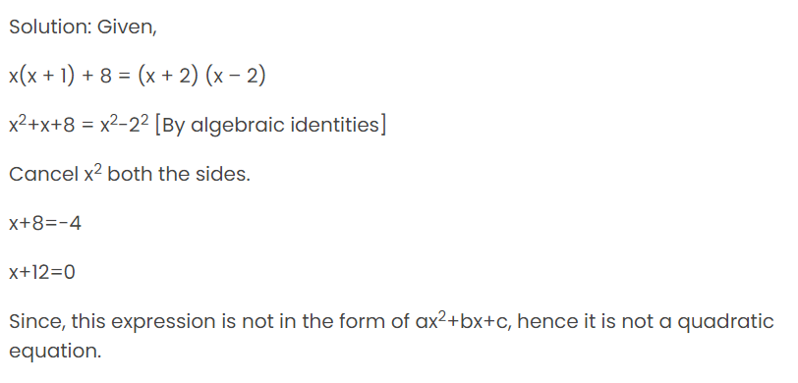
Question 6
Question 1
Check if x(x + 1) + 8 = (x + 2) (x – 2) is in the form of quadratic equation.

Slide 14
Question 7
Question 1
Find the roots of the equation 2x² – 5x + 3 = 0
A. -3/2,1
B. 4,2
C. -5/2,4
D. 3/2,1
Notes:
ANS: D

Slide 15
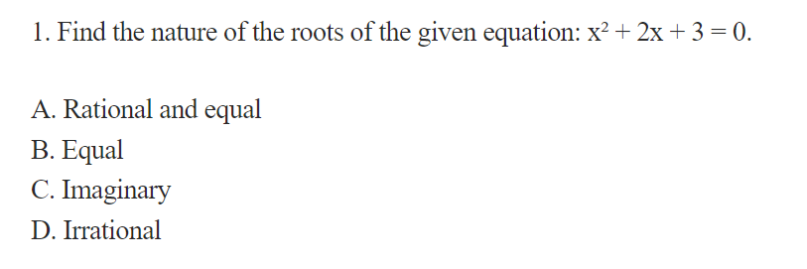
Question 8
Question 1
Notes:
Answer : C

Slide 16
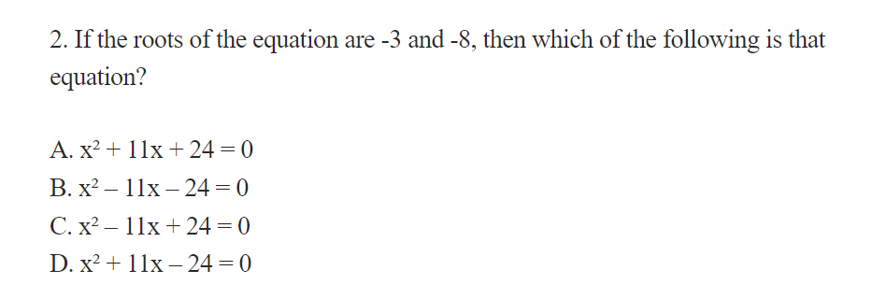
Question 9
Question 1
Notes:
Answer : A

Slide 17
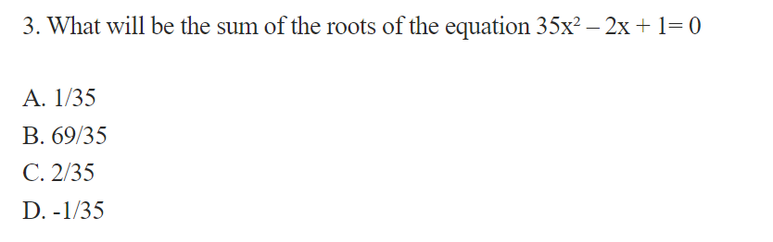
Question 10
Question 1
Notes:
Answer C
-b/a = 2/35

Slide 18
Question 11
Find the roots of x^2-7x+10
A. 2,5
B. -2,-5
C. -2,5
D. 5,-2
Notes:
ANS:A

Slide 19
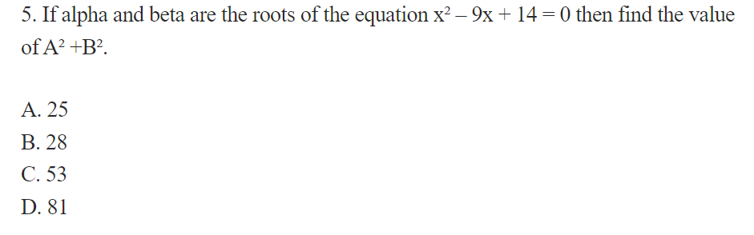
Question 12
Question 1
Notes:
Answer : C

Slide 20
Question 13
Question 1
I. x² + 9x + 20 = 0, II. y² + 5y + 6 = 0 to solve both the equations to find the values of x and y?
Notes:
Answer: Option A
Explanation:
I. x² + 4x + 5x + 20 = 0 =>(x + 4)(x + 5) = 0 => x = -4, -5 II. y² + 3y + 2y + 6 = 0 =>(y + 3)(y + 2) = 0 => y = -3, -2 = x < y.

Slide 21
Question 14
Question 1
I. 9a² + 18a + 5 = 0, II. 2b² + 13b + 20 = 0 to solve both the equations to find the values of a and b?
Notes:
Answer: Option A
Explanation:
I. 9a² + 3a + 15a + 5 = 0 =>(3a + 5)(3a + 1) = 0 => a = -5/3, -1/3 II. 2b² + 8b + 5b + 20 = 0 =>(2b + 5)(b + 4) = 0 => b = -5/2, -4 a is always more than b. a > b.

Slide 22
Question 15
Question 1
1) I) x2 + 28x + 115 = 0
II)y2+ 29y + 138 = 0
a) x > y
b) x ≥ y
c) x = y or relationship can’t be determined.
d) x < y
e) x ≤ y
Notes:
1) Answer: C
x2 + 28x + 115 = 0
x2 + 23x + 5x + 115 = 0
x(x + 23) + 5(x + 23) = 0
(x + 5) (x + 23) = 0
x = -5, -23
y2 + 29y + 138 = 0
y2 + 23y + 6y + 138 = 0
y(y + 23) + 6(y + 23) = 0
(y + 6)(y + 23) = 0
y = -6, -23
Relationship between x and y cannot be established.

Slide 23
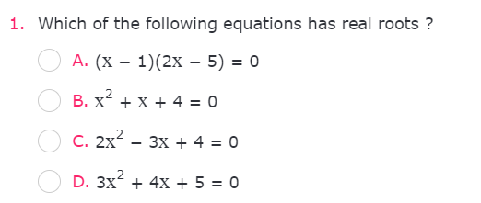
Exercise 1
Question 15

Slide 24
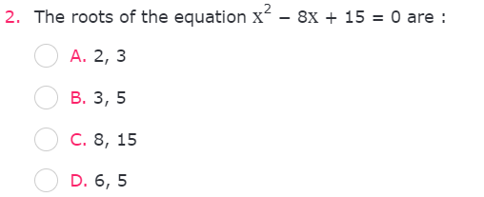
Exercise 2
Question 15

Slide 25
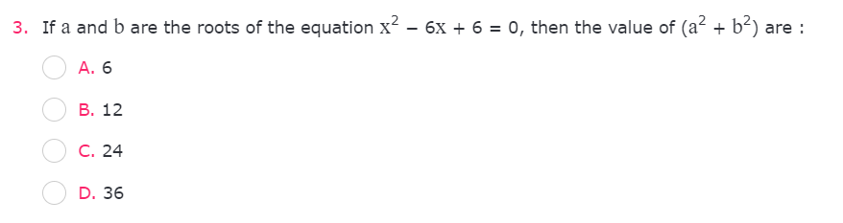
Exercise 3
Question 15
Notes:
ANS:7/25

Slide 26
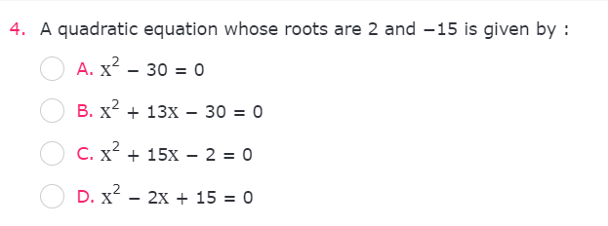
Exercise 4
Question 15

Slide 27
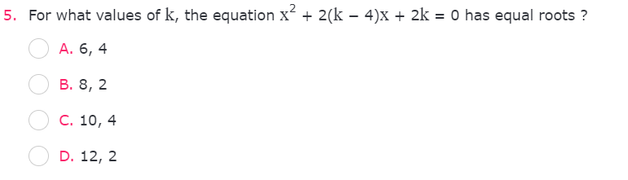
Exercise 5
Question 15

Slide 28
THANK YOU

